Slide 1
Dashcam Defender Team 11 Advised by Dr. Joseph Zambreno Client: Evan Timmons
Durga Darba, Ismael Duran, Cobi Mom, Evan Timmons, Scott Vlasic & Danny Yip

Slide 2
Problem Statement
The roads as we know it today can be filled with reckless drivers.
There is roughly 6 million car accidents in the US every year
What if you knew if a driver has a record of driving incidents due to careless driving?
The solution that we are proposing is the ability for everyday consumers to come together and crowdsource information on reckless drivers
This is done by utilizing DashCam Defender, a product designed by our team to automatically scan license plates and report reckless driver when they are encountered
Ismael Duran

Slide 3
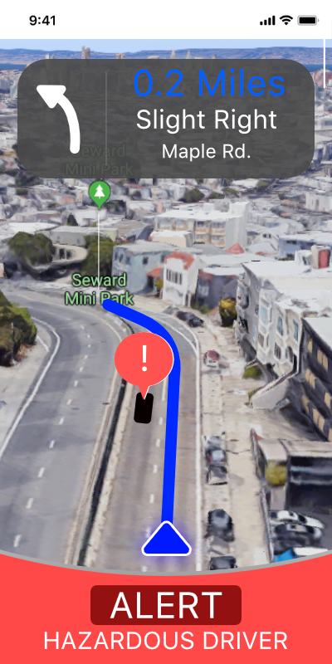
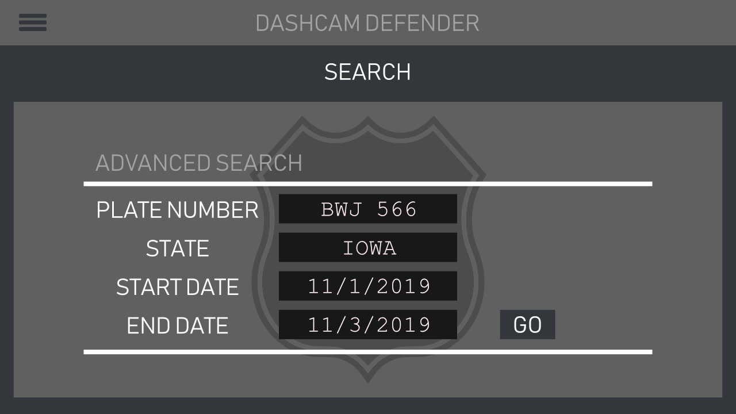
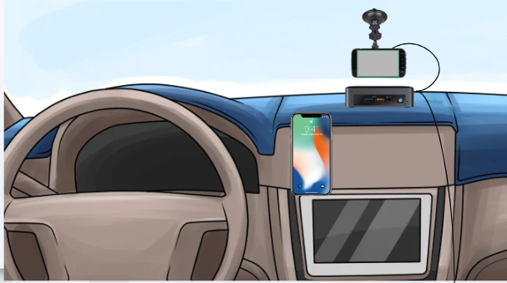
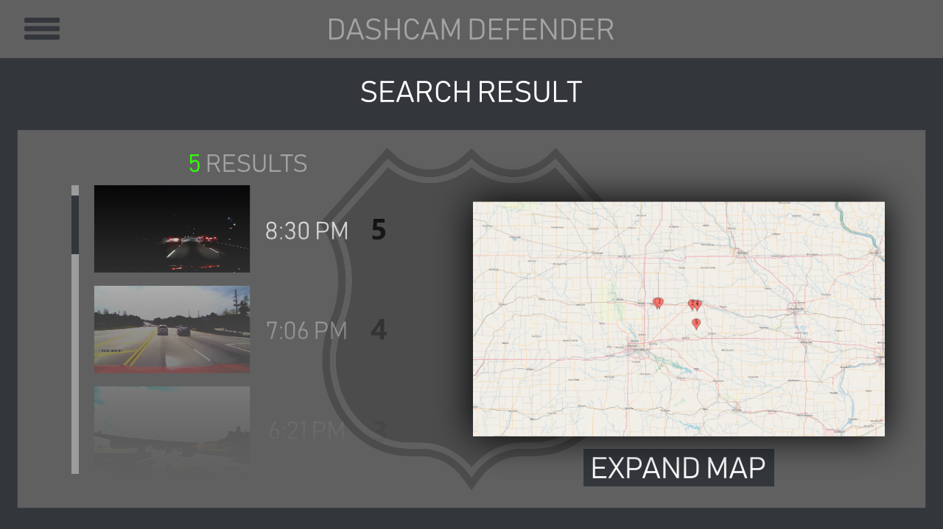
Concept Sketch
Conceptual Layout of Physical Hardware
Mobile App Prototype UI
Law Enforcement Prototype Database
Evan Timmons

Slide 4
Functional Requirements
A license plate reader that can accurately read license plates from nearby cars
A platform where the user can report and view information using mobile and web application
User can record on the road, and it can be used to know their own footage and deal with insurance company if any accident occurs.
Danny Yip

Slide 5
Non-Functional Requirements
Security
login pages, API
Performance
Load testing
Usability
Similarity to other apps
Easy to use database
Compatibility – Runs on multiple environments
Safari, Chrome, Internet Explorer, Firefox
Andriod, iPhone
Durga Darba

Slide 6
Technical / Other Constraints / Considerations
Hardware Technical- Load Open ALPR to Nvidia Jetson to properly read and return license plate
Software Technical – Built mobile application on Flutter, will be working on IOS and Android. Able to get and send data to the database.
Constrains- Due to COVID-19, hardware team are not ready to properly read and return license plate, they try to work on web application instead.
Considerations- Our team will be focusing on hardware part in the next semester.
Danny Yip

Slide 7
Market Survey
60% of motorists believe that aggressive driving is a major personal threat to them and their families
Aggressive driving consists of:
Following too closely, Driving at excessive speeds, Weaving through traffic etc.
We plan to directly tackle this issue through crowdsourcing aggressive driver information
Cobi Mom

Slide 8
Potential Risks & Mitigation
Use of mobile application while driving can be distracting to the driver
We are prioritizing a minimalistic UI with large buttons
Handling user data and privacy is a major concern of users
We are going to have a clear and robust data management policy
NVIDIA Jetson's onboard camera is incompatible with OpenALPR
We've ordered an external camera via the ETG
Cobi Mom

Slide 9
Resource / Cost Estimate
NVIDIA Jetson TX2- Computer to run the OpenALPR software.
SanDisk 256GB SD Card- Memory for the NVIDIA TX2 to ensure testing.
Uzano HD Webcam 1080p- Camera to be connected to the NVIDIA Jetson TX2.
Logitech K400 Plus Wireless Touch Keyboard- Mouse and keyboard that will be helpful with prototype testing.
7-Inch Portable Display Screen- Small monitor to emulate product within the car and assist with prototyping.
Total Cost = ~$450
Scott Vlasic

Slide 10
Project Milestones & Schedule
Durga Darba

Slide 11
Functional Decomposition
Durga Darba

Slide 12
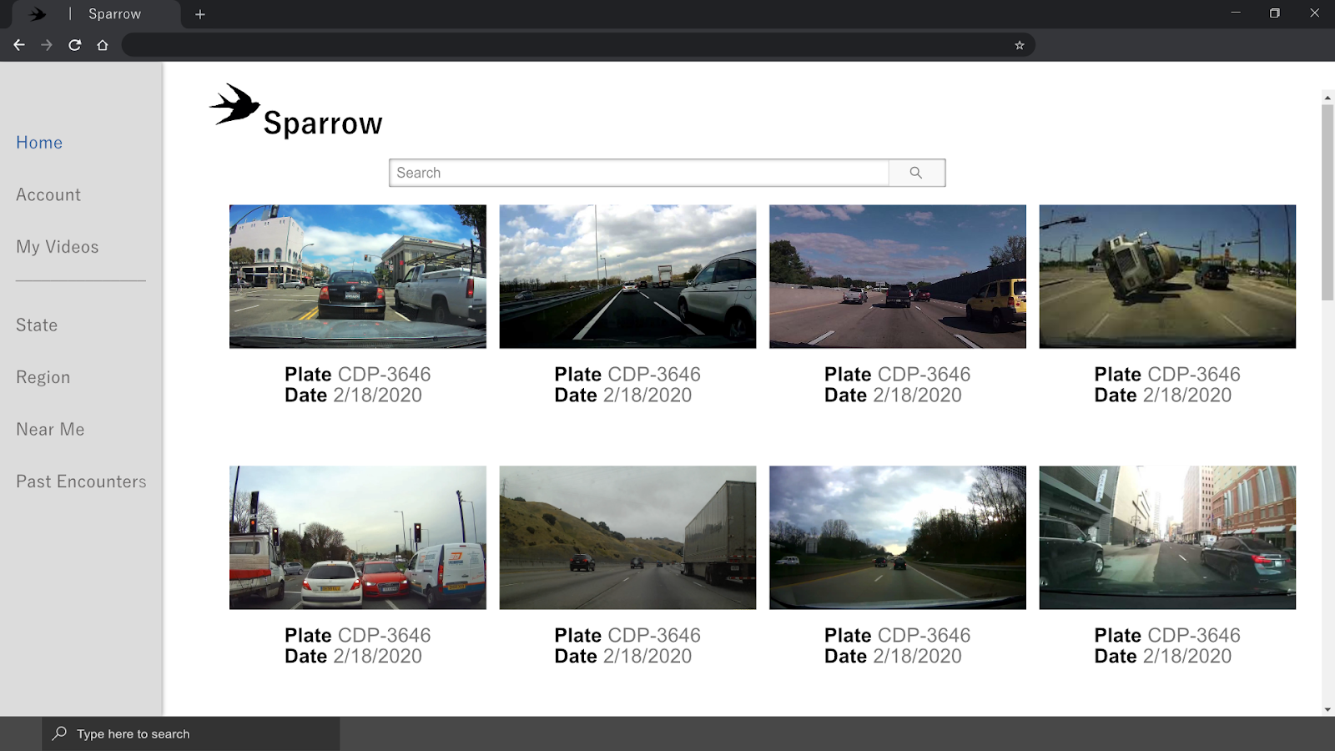
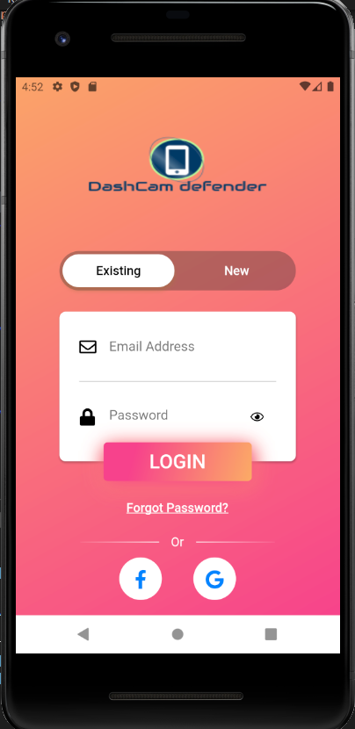
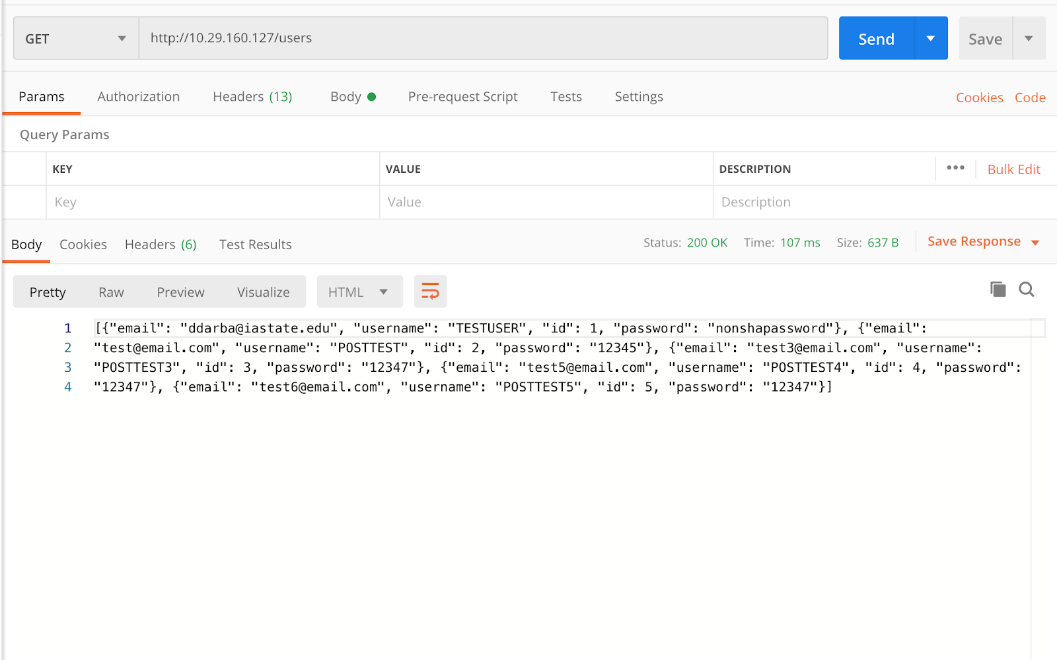
Detailed Design
Website
Developed in Angular
Mobile application
Developed using Flutter
Database and API call
Developed using PostGRES
Ismael Duran

Slide 13
Hardware Platform
To run the OpenALPR license plate detection software, we have purchased the NVIDIA Jetson TX2
Comes with Ubuntu installed on the device
Why?
Documented benchmarks for how the software runs on this hardware device
Meets our I/O needs
Compatible with cameras that run at 1080p
Scott Vlasic

Slide 14
Mobile Application Platform Used
Flutter Framework built on the Dart Programming Language
Why?
Allows for cross platform development
Hot Reload
Good and ever improving documentation provided by Google
Drawback – Lack of familiarity among team members
Cobi Mom

Slide 15
Web Application Platform
To develop the web application, we will be using the Angular framework
Why?
Good documentation and tutorial videos provided from Google
Component-based architecture
Thorough built-in testing (Karma)
Drawback- Lack of familiarity amongst team members
Scott Vlasic

Slide 16
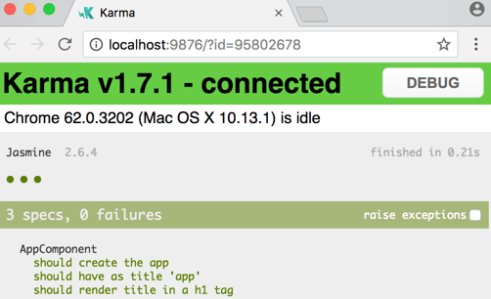
Web Application Test Plan
Jasmine Test Framework
Built in to Angular
Compatible with CLI
Karma Testing Environment
Metrics
Less than 2 seconds to complete all searches
Compatibility with large volumes of videos
1000, 10,000, 100,000+
Stress Testing
Find weak points in system
Attempt 100+ simultaneous viewers
Karma Testing Interface Running Jasmine Tests
Evan Timmons

Slide 17
Mobile Application Test Plan
Currently, we only have simple, straight forward test, by running the mobile application on android and IOS emulator.
We planned to have some automated unit test in flutter, to test the functionality of our mobile application.
The most important test that we should have is :
User can sign up and login.
Able to send and retrieve data from database.
All User interface is working as expected.
Danny Yip

Slide 18
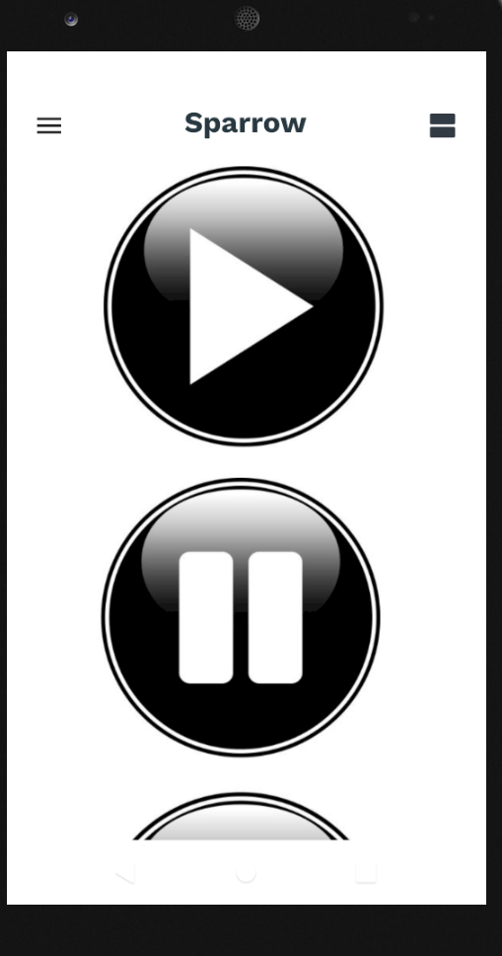
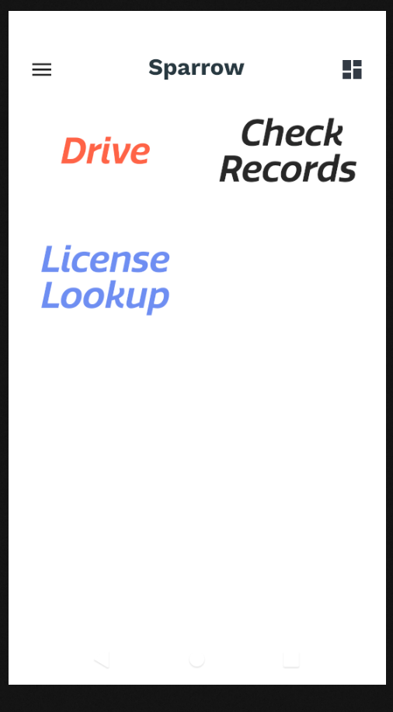
Mobile Application Prototype Implementations
Login
Login with existing account
Driver Safety mode
A layout with big button for drive to press
License lookup
Look up license recently encountered
Ismael Duran

Slide 19
Web Application Implementations
Sparrow
Second semester project name
Search Field
Search by region, state or near you
Account Page
User specific information and details
My Videos
User uploaded videos
Past Encounters
Additional sightings of previously recorded vehicles
Web Application Prototype
Evan Timmons

Slide 20
Database Implementations
Utilizes POST and GET calls to interact with
the database
Currently being integrated with the mobile app
Will be further integrated by the webapp team
Durga Darba

Slide 21
Current Project Status with Respect to Milestones
Hardware Assembly
NVIDIA Jetson TX2 retrieved
Hardware team pivoted to working on the Web Application due to COVID-19
Database Setup
Finished setup, now beginning integration with applications
Mobile Application
Completed login page through mode selection
OpenALPR working with NVIDIA Jetson TX2 w/ Camera
Tested with onboard camera. Ordered a new camera through ETG
Web Application
Platform determined and started prototyping
Cobi Mom
Notes:
This slide will be narrated by Cobi Mom
I’ll be breaking down the current status of our project in chronological order based on the milestones that we have created.
For hardware, we have received the NVIDIA Jetson TX2 and tried the onboard camera, which I’ll explain below.
Due to the ongoing pandemic, the hardware team has since pivoted to focusing on the web application for now because only one person has the TX2 board at the moment
Our database setup is completed and the next step is to integrate it with our mobile and web applications
Our Mobile Application has most of the User interfaces needed for a barebones test and is waiting for integration with the hardware and database
For the license plate recognition, we’ve tested OpenALPR with the onboard camera but compatibility was the issue. We have since ordered an external camera and we are waiting for it to arrive.
For our web application, the team has decided on using Angular and has since been experimenting with it.

Slide 22
Task Responsibility/Contributions of Each Project Member
Hardware Team
Evan Timmons, Durga Darba and Scott Vlasic
Mobile Application team
Ismael Duran, Danny Yip and Cobi Mom
Database Design - Durga Darba
Website Development
Evan Timmons and Scott Vlasic
Ismael Duran

Slide 23
Mobile Plan for Next Semester
Send and retrieve user data from database.
Send recorded video to the database.
Display the live camera's view on mobile application.
Search for vehicle's plate, and able to see their rating.
See the footage of their own vehicles.
Rate the vehicles they have encounter on the road.
Danny Yip

Slide 24
Hardware Plan for Next Semester
Simplified Order Sheet for New Components
Custom Encasing for NVIDIA Jetson Nano_{[1]}
In-Vehicle Testing
Obtain new components
Develop 12V power system for board
Design and Build Custom Enclosure
Evan Timmons
Notes:
[1] https://ae01.alicdn.com/kf/H7933c68caf1a4f4584c5034547b4ca0e9/Waveshare-Metal-Case-Type-B-for-Jetson-Nano-Developer-Kit-Firm-dust-resistance-nice-looking.jpg

Slide 25
Web Application Plan for Next Semester
Retrieve driving recordings from the database
View footage of past driving sessions
View footage based on license plate number
Implement effective search function
Search for a license plate number and see that driver's driving score
Scott Vlasic

Slide 26
Thank you!

